Slide 1

Faster Read Webinar 16/7/2024
Julia Sutherland, Jo Westbrook, Jane Oakhill
Claire Durrant, Deborah Upchurch and Tara McMullan (Research Assistants)
University of Sussex

Slide 2


Welcome! Pls put any notes in the CHAT:
Your name, school/university or place of work
New or experienced Faster Read teacher
Reflect on these questions…
1) How do students read and comprehend whole texts?
2) Implications for how we teach reading?
NB This webinar is being recorded.

Slide 3
Aims of webinar
Outline our Faster Read pedagogy, rationale & impact in our first research study and now, 10 years on.
Share your versions & ideas on how you are using the Faster Read:
What’s working well? Why? What are the challenges? Choice of texts?
Questions & where do we go from here? e.g. Network for teacher support…
How do students read and comprehend whole texts?
Implications for developing reading, especially for struggling & disadvantaged readers?
Notes:
Guidance on FR website: Teacher Guidelines & video – see link on final slides
Creating a network (name, role, school, photo, your school email)
Sharing great, culturally diverse, engaging & challenging texts
Sharing schemes of work

Slide 4

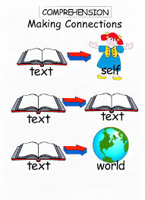
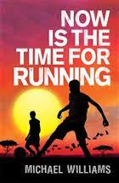

How do readers comprehend a whole text?
decode; reading fluently & automatically - effortless, unconscious
use vocab. knowledge (oral comprehension) & be able to infer new vocab
make sense of sentences – grammar, syntax, pronouns (Sally…she…)
Role of inference - infer at paragraph level – bring knowledge to text to add meaning & fill in in gaps: waves, bucket, decking = setting; use clues: chapter titles.
Infer at global/text level – apply knowledge of human behaviour to infer characters’ motivations; context (WWII, S. Africa), other texts?
Build a mental model of the text & adapt it as we read (e.g. Kintsch, 1998)
Make connections across the text – role of memory
Draw on understanding of story-structure/genre, predict & navigate our way, using knowledge of other books, films, etc
Monitor comprehension to remove confusion; choose/apply a reading strategy
Read quickly enough to maintain our model, recall & integrate details
Be motivated to persist/overcome challenges, reach the end; know it’s worth it!
Notes:
Reciprocal relation between reading skill, exposure to print & reading comprehension – the Matthew Effect – the ‘rich’ get richer, the ‘poor’, poorer… (Cunningham & Stanovich, 1984; van Bergen et al, 2020; Mol & Bus, 2011)
Reading for pleasure at 10 years helps overcome disadvantage - a stronger predictor of GCSE success than parents’ education (Sullivan & Brown, 2015).
RATIONALE for FR – 2 factors are crucial to developing reading comprehension:
Reading volume – see, e.g. Cunningham and Stanovich – students need to read/practise comprehending a large number of texts to improve their comprehension. There is a reciprocal relation between initial level of reading skill and developing reading comprehension, which is mediated by the number of books read. So, if you are a competent reader, you will typically read more books and thus improve your comprehension, compared with a weaker reader, who reads less independently or at all, therefore falling further behind. The more you read, the better you get at it! See all research on importance of reading independently or for pleasure – Allington et al, 2010; Cremin, Cliff-Hodges, etc – and Sullivan and Brown, 2015 (Reading for Pleasure at 10 years is a better predictor of success at GCSE level across subjects than parents’ level of education. Reading a lot/for pleasure supports good reading comprehension. See Stanovich’s virtuous reading circle.
Reading engagement (being engaged in the act of reading, which includes being motivated to keep reading). There is extensive evidence on the impact of reading engagement on comprehension. i.e. the more you read and are motivated to keep reading, even when it is difficult, the better you become at reading comp. and overcoming reading challenges. This is partly also because you develop the other essential aspects of reading: vocabulary, syntax and grammar, general knowledge (of the world, personal knowledge and textual knowledge) needed to be able to make good inferences, inference-making as a skill, an understanding of how narratives ‘work’ (called story-structure) and of different genres, etc – all of this knowledge helps readers to read subsequent books..
Research on the importance of motivation includes developing the reader’s ‘drive for coherence’ (van den Broek, 1997). i.e. readers need to be excited by the narrative and want to know what happens next. This makes them work hard at making sense of the text (Taboada et al, 2009) because they can anticipate the pleasure they will experience of knowing the ending when all threads are woven together.
Role of engagement & reader identity; Good readers, who read a lot develop positive reading self-concepts or reader identities. Ie they feel confident in their reading skill and so believe that they can overcome reading challenges by being persistent/applying strategies etc. So it’s important to make students feel they are competent readers with strong reader identities so that they persist. Research shows how important this positive reading self-concept is for developing persistence & good reading habits (Retelsdorf et al, 2011; Cremin et al, 2014, Cliff-Hodges, 2014; Guthrie & Klauda, 2014).
Choice of texts - becoming a ‘reader’: diverse text representations, where children see themselves represented is also important.
Fluency and reading aloud: Fluency of oral reading aloud improves skills of speed, effortlessness, autonomy and lack of conscious awareness – all of which strongly support comprehension. The teacher or a fluent peer reading aloud expressively, with appropriate intonation also supports fluency for other readers, not just the actual reader reading aloud (NICHHD 2000; Duncan 2015), but this should be supported by all students also practising reading aloud in groups.
NB Jane Oakhill & Cain (2012) found that the 3 skills that were the strongest predictors for developing reading comprehension are: inference, story-structure & self-monitoring of one’s
Compounding effect of disadvantage: there is a language gap of 18 months at 3 yrs between children from the wealthiest families and the most deprived & the reading-experience gap magnifies over time (Blanden & Machin, 2010; Hart & Risley, 2003; NLT, 2022; Baye et al, 2019)
Community reading & dialogic talk: class/groups: reading aloud for interpreting, enjoyment, fluency & using reading strategies in a metacognitive way (e.g. Okkinga et al, 2014; Sutherland, 2015)

Slide 5
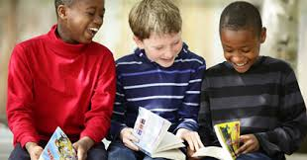
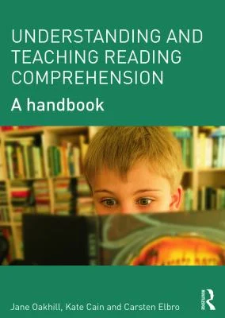

Why do struggling & disadvantaged readers have difficulties with reading comprehension?
Difficulties with language processing – all effort used on decoding
More limited vocabulary
Difficulties with inference at all levels
Less background knowledge to make inferences thro’ lack of reading & fewer opportunities to acquire general knowledge via talk & experiences
Weaknesses in working memory to process whole text, recall details from earlier chapters, knit text together to ‘make sense’ of it
Lack of reading experience/exposure to print, motivation + reading anxiety. Extended whole-text reading, engagement & motivation are critical to reading development, persisting when there are challenges & being confident that you can overcome these (Stanovich and Cunningham, 1998; Mol & Bus, 2011; van Bergen et al, 2020; Guthrie & Klauda, 2014; van den Broek, 1997 – the ‘drive for coherence’, Retelsdorf et al, 2011; Taboada et al, 2009)
Notes:
Students from disadvantaged backgrounds less likely to read for pleasure & enjoy reading BUT access to books & encouragement can change this (Clark & Akerman, 2011; Allington et al, 2010; Cremin et al, 2014). We know that reading for pleasure supports learning across the curriculum: Reading for pleasure at 10 years helps overcome disadvantage - a stronger predictor of GCSE success than parents’ education (Sullivan & Brown, 2015).
BUT - Policy UK & US - How much time is actually spent on reading whole texts in English? Is reading for pleasure expected to occur elsewhere, e.g. DEAR?
So, schools are expecting too much of struggling readers to assume that reading practice must take place, volitionally, outside lessons. We need to reverse this and give struggling readers sufficient reading experience of extended texts to develop their reading comprehension INSIDE Lessons.
Struggling readers have difficulties with inference at all levels - inferring meaning of new words, making links across paragraphs & applying background knowledge to make inferences re setting, plot, character’s motivations
Struggling readers also have weaknesses in memory and language processing so need to gain reading skills (questioning, inferring, summarising, predicting, etc), through experience of whole-text reading, motivation & confidence as ‘readers’ (Stanovich, 1986; Mol & Bus, 2011; van de Broek, 1997) AND through explicit teaching of those reading strategies so that they internalise these and can use them independently.
Oakhill, Cain & Elbro (2015) – excellent book on reading comp, including struggling readers, written for teachers

Slide 6
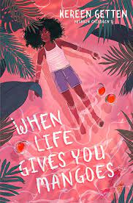

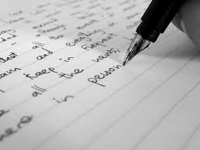
How is reading taught in 11-14 years classrooms?
Where is whole-text reading expected to take place?
Practice, 2014…Now?
Faster Read
Slow, fragmented read of 1 text
Focus on written analysis, by reading extracts - & micro-analysis: the ‘Naming of Parts’
Text choice: Victorian, canonical, unrepresentative of student identities, no focus on engagement
Interrupted: short chunks: ‘read a bit, write a lot, read a bit, write a lot’; unengaging
Whole-class or Individual; little group reading/discussion
Comprehension is ‘assumed’: little checking or focus of whole-text comprehension, especially ‘struggling readers’
Literary criticism for GCSE testing at 16 years: Why has the author used that metaphor?
Increased amount & pace of whole-text reading: Faster, immersive read - 2+ whole texts: 1 term
Focus on reading comprehension/interpretation AND engagement – pleasurable reading in lessons with discussion
Text choice: engaging, challenging, culturally diverse
Uninterrupted – reading like a ‘reader’: longer chunks read aloud & expressively
Group reading & dialogic class talk: questioning, meaning-making: develop reader identity & habits
Explicit teaching & group modelling of inference & reading strategies + Oral assessments
Whole-text comprehension; making connections across/beyond - Big themes & personal response
Inference to…. Analysis & Critical reading
Notes:
Pedagogy for KS3 (and KS2) skewed towards the requirements of KS2 SATs or GCSE at 16. No focus on extended, whole-text reading, which is the only way that struggling readers will ever ‘catch up’ and gain sufficiently good reading comp skills to access the secondary curriculum.
Pedagogy all geared towards written analysis of small extracts with a focus on literary features like similes, etc. So struggling readers fall further behind as they lack experience of comprehending a whole text, which would greatly strengthen their comp. skills for future reading.
.

Slide 7

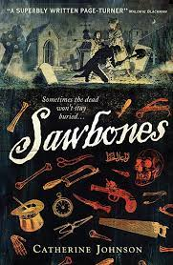
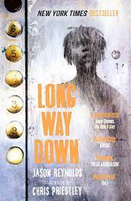
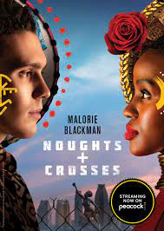



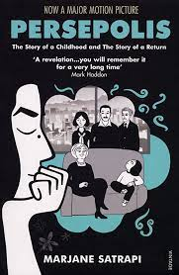
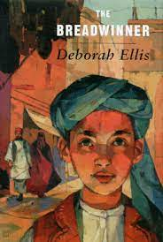
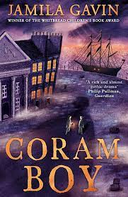
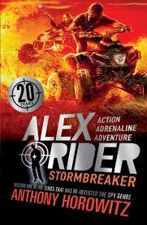
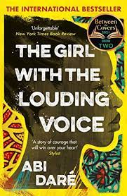



Notes:
Since BLM, teachers now are using more culturally diverse texts, but we started this recommendation in 2014 as part of engaging and motivating struggling readers, who are reluctant readers and need to be hooked into enthusiastic, motivated reading. Here’s some examples of text pairs from our original study AND from our impact study 10 years later
NB Texts chosen at KS3 should be highly engaging, challenging & culturally diverse so that students, esp. weaker readers, who are not used to reading and enjoying whole books, are motivated to read to the end and gain a rich reading experience. None of our teachers chose Victorian novels as these are unlikely to be engaging for struggling readers as the language demands are too great.
Motivation in reading supports comprehension skills so it is essential to choose books that your particular class will enjoy so that they can become immersed in reading and practising the skills of whole-text reading that will turn them into ‘readers’ - develop their skills, make them feel more confident about reading because if they get stuck, they have some strategies to help them resolve their ‘block’ and given them the practise in reading whole texts that many students in our study said they had never experienced.
Only 28% of adolescent students read for pleasure each day, the lowest figure since National Literacy Trust (2023) started doing annual surveys in the UK. So it is imperative that, as English teachers, we re-engage KS3 students, esp. weaker readers, with the pleasure of reading a whole, challenging text and wanting to know what happens next.
Ofsted (2019) have urged schools to do a different curriculum at KS3 from KS4 so this study illustrated that text choice was very important. We should not see KS3 as all about a narrow ‘preparation’ for handling unseen Victorian extracts at GCSE and therefore having a diet of Victorian novels from Year 7. This will not develop the crucial reading skills, motivation and reading self-concept – ie belief that you are a capable reader & can tackle difficulties you encounter in reading – that all readers need. So choose contemporary and YA texts that will engage and challenge your KS3 readers.

Slide 8
3 components: (1) Faster, immersive reading aloud of 2 high-quality, whole, culturally diverse texts, well-paired in a term. Focus on comprehension & engagement, using dialogic talk & questions
(2) Explicit development of reading strategies: inference, story-structure (use graphic organisers), monitoring of comprehension, questioning, predicting, summarising, visualising, empathising
(3) Group reading aloud & dialogic discussion – to practise reading, asking authentic questions & enjoying a narrative with peers. Groups use reading strategies to resolve sticking points, developing habits, persistence & confident reader identities, across whole texts.
Notes:
Faster, immersive read of two whole, challenging, culturally diverse novels, back-to-back in a term: focus on reading comprehension & narrative engagement, including expressive, pacy reading aloud by teacher to support mental model & links being made across text
Explicit development of students’ reading strategies: inference, understanding of story-structure (with graphic organisers), self-monitoring of comprehension, questioning, predicting, summarising, visualising, empathising, to support comprehension at sentence/chapter/text level
Group reading and discussion to practise reading aloud, questioning & using other reading strategies to resolve sticking points, enjoy and engage with a narrative with peers, developing habits, practice, confidence and identity of ‘being a reader’
The Faster, immersive read model of reading: Why is it important now? Covid context of reading & learning losses, esp. for disadvantaged students and struggling readers as no reading practice at home, whereas literacy-rich homes with books intensified their reading with students
There is strong evidence from our original study and the impact studies 3 and 8 years later that reading 2 books in a term enables all readers – poor, average and good readers – to make good progress. NB we also looked at the progress of other groups – SEND and PP. Again, the study showed that there was no difference, on average, with their progress than the other groups. Boys also made comparable progress with girls although the boys on average, started at a lower point (so ended on a lower level).

Slide 9
Struggling readers made 16 months’ comprehension progress in 12 weeks in reading tests. Students increased reading engagement, confidence, persistence, reader identity, enjoyment of English & group reading.
Some evidence of improving writing - even stronger in 10-year impact study!
FINDINGS, FIRST STUDY
Diverse schools, incl. deprived areas.
N=413 Year 8s, 20 English classes -
‘low-attaining’ & mixed-ability:
44% ‘struggling readers’
Mixed-method: standardised reading tests, observations, teacher interviews.
RQs: 1) Can the FR enhance reading levels?
2) Which factors contribute to any development?
Teachers need knowledge about struggling readers, strategies & reading experiences required to develop reading. Extended, pleasurable reading must occur inside lessons, not just outside as optional ‘Reading for Pleasure’!
28% stds read for pleasure daily
60% FSM stds don’t enjoy reading
(NLT, 2023 Survey)
Notes:
Faster, immersive read of two whole, challenging, culturally diverse novels, back-to-back in a term: focus on reading comprehension & narrative engagement, including expressive, pacy reading aloud by teacher to support mental model & links being made across text
Explicit development of students’ reading strategies: inference, understanding of story-structure (with graphic organisers), self-monitoring of comprehension, questioning, predicting, summarising, visualising, empathising, to support comprehension at sentence/chapter/text level
Group reading and discussion to practise reading aloud, questioning & using other reading strategies to resolve sticking points, enjoy and engage with a narrative with peers, developing habits, practice, confidence and identity of ‘being a reader’
The Faster, immersive read model of reading: Why is it important now? Covid context of reading & learning losses, esp. for disadvantaged students and struggling readers as no reading practice at home, whereas literacy-rich homes with books intensified their reading with students
There is strong evidence from our original study and the impact studies 3 and 8 years later that reading 2 books in a term enables all readers – poor, average and good readers – to make good progress. NB we also looked at the progress of other groups – SEND and PP. Again, the study showed that there was no difference, on average, with their progress than the other groups. Boys also made comparable progress with girls although the boys on average, started at a lower point (so ended on a lower level).

Slide 10
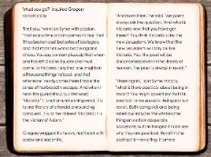


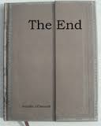
So how did teachers move students through the text?
Fast paced sustained reading for 20 - 40 minutes or even whole lesson
for 3-4 weeks, then 2 weeks to deepen understanding + analysis
Whole class: teacher or fluent readers reading aloud to maintain motivation
Lots of recaps & connections made across the book + timelines on wall, etc
‘Interruptions’ only to recap for 30 seconds, where there are ‘sticking points’, check understanding of plot, setting, vocabulary
Text experienced as a whole
Girl 1: Are we going to read for the entire lesson?
Boy 1: Are we going to finish it today?
Before, there’s been a massive dip in the middle of ‘The Curious Incident’ & we lost momentum – too many pointless writing tasks - but the faster read really helped to keep the enthusiasm going

Slide 11
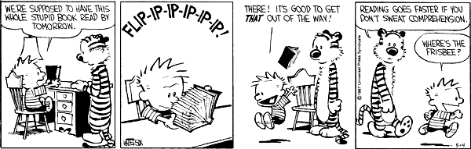
Not sweating comprehension!

Slide 12

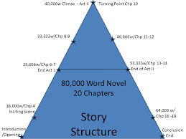
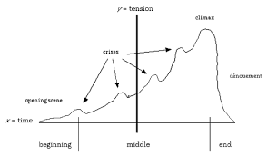
Teaching whole story structure
Timelines: dates, photos – dual narrative - Private Peaceful
Maps tracking characters’ journeys
Graphs – plot highs and lows, quotations
Event wheels
Family trees
Plot-sequencing: using sentences & images
Referencing up and down the whole text

Slide 13

Reading a second text back-to back
‘...it's very liberating for me. I've never in 27 years of teaching just read 2 texts back-to-back!
(Anna, Comparison Teacher)
Reinforced comprehension skills: questioning, predicting, clarifying, inferring, making connections - & practising these properly
Increases volume of text read over 12 weeks
Supports intertextuality and comparison
Students grew more competent, confident, Created an enthusiastic reading community
Raised teacher expectations of their students
I don’t think they have read this much in such a short space of time or ever and I didn’t for a minute expect that they would keep up. It’s going to help their reading enormously but I think we just have to keep on doing it. (Penny Intervention)
It’s a release for me, I love it! Its’ fantastic, amazing! (Jane, Comparison Teacher)

Slide 14
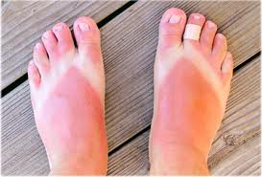
What is inference? What can we infer from this image?
What did you have to know about to be able to infer these things?
Notes:
Many thanks to Sussex teacher and reading expert, Claire Willis, for this slide on how to teach inference, using visual images, and for subsequent slides on The Curious Incident of the Dog in the Night-time

Slide 15
1) What inferences must you make to comprehend this passage? i.e. which parts might confuse weak readers?
2) What kinds of knowledge are you drawing on to help you?
There were a lot of wreaths delivered to the church and Father was proud of the fact that one of them had been sent by the Fury, but when Mother heard, she said that Grandmother would turn in her grave if she knew it was there.

Slide 16
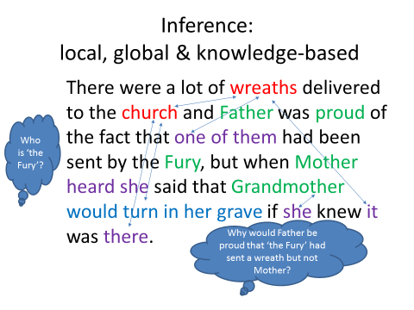

Slide 17

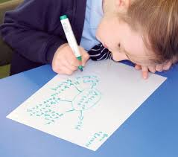
What is Group Reading? Why important?
Every question is a good question!
Stable, reading-ability groups 4-5, trusting atmosphere OR mixed-ability groups, ‘complete reading circle’: 15-20 mins
Teacher guides each group before practising alone: models how readers read expressively, then question, clarify, infer, predict, summarise, make connections across text, visualise
Different group models: fluent reader maintains pace, other readers read dialogue as ‘play-script’; or rotating roles: leader, questioner, clarifier or vocab-monitor.
Mini whiteboards to take vocabulary & questions to class
Culture develops: What does it mean to be a reader? Dialogic space: readers model how to comprehend, ask questions – literal & high inference - & have different interpretations
Allows time to practise & internalise reading strategies
Start with more structured tasks, then move to independence
What does xenophobia mean?
Why is Deo so upset here?
What happened earlier when…? This reminds me of…
Notes:
(Extensive evidence: Palincsar & Brown, 1984: Reciprocal Teaching, RT; Applebee et al, 2003; Sutherland, 2006, 2015. Reciprocal reading is a form of Guided reading.)
Spend time enabling rapport to develop with the GR groups – choose groups carefully to be supportive of each other’s needs and esp. of reading needs – e.g. personalities & reading strengths: balancing student who is a fluent & quite expressive reader with those who have other skills, e.g. good vocab, good knowledge to apply for understanding the context of the book, motivated in reading, good at keeping the group on task or asking questions, etc.
Ask groups to create their own ground-rules or guidelines for productive group talk about reading (see other Word doc: Guidelines for a Faster read for some examples) & encourage them to reflect on whether they are getting better at doing guided reading and being a supportive group, asking good questions, understanding and exploring the text well, as time goes on.
It’s much easier to do GR when you know your students well – ie avoid early in Autumn term – advice from teacher in School 21, London.

Slide 18





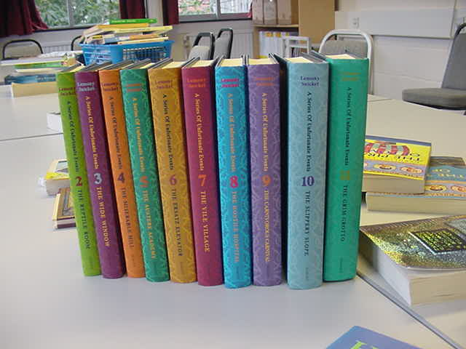
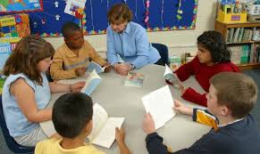

Reading strategies
Notes:
Reading Strategies keyring – all students made their own version of this and had it with them in lessons. When the class read, the teacher encouraged students to identify the strategy they were using – e.g. Today, we’ll particularly focus on inference or prediction, etc. This made the strategies very explicit so students knew they could use any of these to repair comprehension. From top left hand corner – crystal ball = prediction; question mark – student questions; globe = applying world knowledge; Me = remember to apply your personal knowledge to the book and have a personal response (empathise with the characters, discuss what it must feel like to be frightened for your brother, etc); Books = applying knowledge of other texts/intertextuality; group talk – remember to discuss ideas with peers to resolve comprehension; re-search picture = try to break words down/use knowledge of morphology to infer a word (militate – military) or infer what they mean from the context; Sherlock and his magnifying glass = inference, of course! Students need this metalanguage of key strategies, but these visual images on a keyring were very helpful in enabling the students to recall these.
Many thanks to Lauren Haywood, Director of English and reading expert, for this innovation – Peacehaven Community School – see the video with Lauren talking about the project with other teachers at the end of these slides

Slide 19
Who are ‘we’?
Modelling Inference questions
Is this a town or a village?
Is this a town or a village?
We walk to Bikita to see Captain Washington. He is the best policeman in the district. I will tell him what happened in Gutu, what happened to Amai and Grandpa Longdrop and the others. He will know what to do. Bikita is three hours’ walk on the normal path from Gutu, but we do not walk on that path. It is the road that the soldiers used. If they should come back they will see us. We walk the long way.
Why? What does this show about
his character? Relationship?
How far would you get if you walked for 3 hours out of Brighton? What does this show about the boys’ journey?
Why is Deo so scared of the soldiers? What happened earlier in the book?
Notes:
Many thanks to Brighton teacher and reading expert, Liz Uren for this slide, focusing on modelling to students HOW to ask useful questions to monitor their comprehension – you’re going to have a go at a similar task with a short story shortly

Slide 20
Any Questions? Discussion & Break-out rooms
Experienced teachers talk about their experiences of the FR & inexperienced teachers explore questions & issues
How have you been using the Faster Read – your version of it?
What works well for you?
What are the challenges? How have you overcome these?
If you are new to it, what do you envisage will be challenges for you in your school and current curriculum?
Bring any issues/questions to plenary…
Notes:
Some Challenges for Teachers -
Radical change to curriculum: will HoD/SMT support, long-term?
Getting through 2 whole novels, back-to-back, in one term
Fear of being caught ‘just reading’ by Learning walks & Ofsted
Will writing suffer with a primary focus on reading with talk? (Teachers’ fears were not justified; many said writing had improved with this focus on reading because students had wider vocabs & greater understanding of text structure, which they transferred to their own writing.)
Assessing reading through talk – how to record this?
Where’s the evidence of progress? How much writing is in the books?
Daring to focus on whole-text comprehension, not analysis/PETAL paragraphs. Will students perform well in written, analysis assessments?
Using guided reading & group work more often/every lesson
Getting through 2 whole novels in 1 term & maintaining reading engagement in longer lessons (100- minute); balance bet. reading aloud, discussing text & teaching reading strategies & vocab?
Curriculum constraints: how to fit in end-of-term written assessments?
In tension with KS3 ‘Mastery Curriculum’ & performative system, including Ofsted
Where’s the written evidence of progress? How much writing is in the books? Will writing suffer with a primary focus on reading & talk? (Evidence: many teachers report creative & analytical writing has improved with wider vocab used and more understanding of text-structure. One teacher showed Lord of Flies essays to Ofsted to justify spending 30-40 minutes reading, while they observed. Ofsted agreed essays showed strong impact of FR on quality of analytical writing)
Culture change: How to assess reading via talk as teachers not used to this? (Taping of group reading/talk; quick online quizzes; hot-seating; students use quick graphic organisers while discussing text, e.g. timelines, event maps, story mountains; use of 6 oral flashbacks on post-its at start of lesson to assess recall of plot/characters; quick blogs/tweets re characters)
Using reading groups & discussion more often: cultural change for teachers; some academies resist group talk
Cost of new books
‘Just reading, not!’ Recognise the need for rich CPD
Structural challenges – e.g. will SMT support this initiative? – remain, but teachers have largely resolved the other issues on this slide, by practising the model and adapting it to their contexts. E.g. most do it in the Autumn term so that every year group starts with the faster read and 2 novels, to kick-start the year and embed excellent reading and dialogic talk practices, but some teachers do the model in the Spring term.
NB Now that the FR is cited in the Ofsted paper on Research-informed approaches to English teaching, will policy gradually shift towards a recognition of the need for more whole-text focus on comp/interpretation at KS3 and less on the Naming of Parts – micro-analysis?

Slide 21
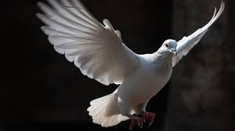
The End…Impact of the Faster Read?
How far has it spread? Impact study: 2022
N= 208 Teachers: Online survey (n= 183), targeting known FR users & via social media + 25 Teacher interviews + 12 Lesson-observations.
Headline Findings:
208+ schools, 40,000+ students & 1000+ teachers currently using it – UK!
Primary, Secondary, Alternative Provision, Special Education
Estimated 10+ ITE courses teach the FR in reading curriculum
70% report all/most of English Department use FR; 99% recommend it
48% adopted it during/just post-Covid to avoid reading losses/as a ‘catch up’
22% have used it for 4-8 years
49% have used it with 11-32 classes – multiplier effects
Some MATs now spreading it across their schools, via agentive Heads
Teachers have spread FR because it ‘works’ & resonates with beliefs
Notes:
The FR has been greatly spread by teachers, who have passed it on to their networks, spoken about it at their teacher conferences and spread it via Social Media, in addition to the research team doing many CPD events, conferences writing articles and book chapters, etc. So, teachers have been very agentive in spreading the Faster Read across the country because they could see ‘it works’ to raise reading levels and engagement in their classes.

Slide 22
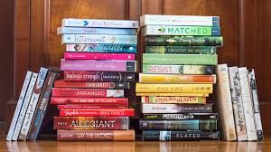
Majority of teachers, survey/interviews say…
Strong impact on KS2, KS3, GCSE & even A Level, improving:
Reading comprehension levels, vocab, reading engagement, identity, confidence: ‘joy of reading’. Large gains for struggling and disadvantaged readers
Understanding whole novel aids complex interpretation, comparison, analysis of structure
Increased no. of texts read: 18 novels in KS3: 11-14 years; many read 9+ texts
Many also say:
Improved analytical or creative writing, & engagement with ‘Big ideas’
Rich oracy & community of readers at centre: develops students’ capacity to express complex ideas, empathy, social skills post-Covid (see Oakhill et al, current work)
Therapeutic benefits for all during/post-Covid, especially those excluded from mainstream. Some say: raises attendance and engagement with school
Teachers’ version of FR similar to ours; some only read 1 longer text; some use visualiser, not books – cost of buying new diverse texts – variable impact; some use less group reading/talk – but some misconceptions
Notes:
Teachers often replicated their study in the schools and used standardised tests to measure comprehension, reporting great gains – see the videos with weblinks of teachers talking about their successful experience of using the FR on a later slide

Slide 23
Reading is power: students lack the confidence or ability to read these texts on their own. Empower your young people.
Give students the gift of a whole book, a whole journey for its characters, and this supports them in becoming better equipped for the world beyond school.
I justified reading for 30 minutes with Ofsted, by citing the research and they looked at students’ Lord of the Flies essays and were convinced.
A girl often excluded for poor behaviour now attends, sees herself as a reader, loves reading & asking questions of books!
I read to them in their own homes during Covid and one girl is dyslexic and it’s changed her mindset about what reading is, and she really enjoyed it. Their parents enjoyed being read to, too!
We’re bucking the national trend as many students do English Literature at A Level (Tower Hamlets & Sussex)
What if Ofsted come, what if my Head Teacher comes? What if I have an observation? So, we felt like reading was cheating…And I love that freedom to say to my new teachers now: ‘Reading is the work…Don’t worry about the theory behind it - Just try the Faster Read for yourself and see what happens.. in my class the impact was not just on their reading, which was phenomenal, but on their writing – it leapt ahead!’ (Head Teacher recollecting)
Notes:
These are teacher quotations from the survey and interviews in our impact study after 8 years.

Slide 24
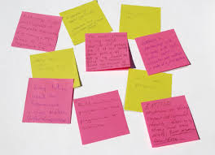
Many thanks for listening!
Questions & where do we go from here?
Would you like to join our FR Network?
Pls email Claire, C.Durrant@sussex.ac.uk
Your name, role, school, own school email & photo, if if if wished, to display on our website
Sussex Website below for the Faster Read, includes:
Video of teachers talking about the FR
Guidance for teachers
Network members’ details if happy to liaise with other teachers and us about approaches to using the Faster Read pedagogy
https://www.sussex.ac.uk/research/centres/centre-for-international-education/projects/fasterread/impact
Email me for more information or to join our network: jcs23@sussex.ac.uk

Slide 25
Authors’ publications on The Faster Read
Sutherland, J., Westbrook, J., Oakhill, J., & Sullivan, S. (2023) An immersive, ‘Faster Read’: a pilot, mixed-method study, developing whole-text reading comprehension and engagement with adolescent struggling readers, Research Papers in Education, No. ahead-of-print, 1-23 https://www.tandfonline.com/doi/epub/10.1080/02671522.2023.2238285?needAccess=true&role=button
Sutherland, J. and Westbrook, J. (2022) ‘Reading Comprehension’ in A. Watson & R. Newman (Eds), A Practical Guide to teaching English in the secondary school, London: Routledge.
Sutherland, J. and Westbrook, J. (2024) How do students read, interpret whole texts and become engaged readers? In Smith, L. Secondary English for Generation Alpha: Humane Pedagogy for Local, National and International Contexts, London: NATE/Routledge series
Westbrook, J., Sutherland, J., Oakhill, J. and Sullivan, S. (2019) ‘Just reading’: the impact of a faster pace of reading narratives on the comprehension of poorer adolescent readers in English classrooms. Literacy, 53(2) 61-68
For publication later this year:
Sutherland, J. and Westbrook, J. (2024) How do students read, interpret whole texts and become engaged readers? In Smith, L. Secondary English for Generation Alpha: Humane Pedagogy for Local, National and International Contexts, London: NATE/Routledge series
Sutherland, and J., Westbrook, (2024) ‘Not the Naming of Parts’: the impact of the Faster Read on teachers, students and reading practices in the UK after ten years (in draft)

Slide 26
Secondary & Primary Teachers replicating the Faster Read and talking about their experiences independently:
Gloucester Road Infant/Primary School https://films.myattandco.com/programs/a-faster-read-primary-project-part-1
Gayle Fletcher and Lauren Haines: 93% of pupils in Year 2 & 83% in Year 4 made more than six months progress after 12 weeks of FR
St Michael’s Church of England Primary School: https://marymyatt.substack.com/p/end-of-year-the-best-bits
Nene Park Academy, Peterborough – raises reading levels & encourages independent RfP & culture of reading
https://films.myattandco.com/programs/a-faster-read-nene-park-academy-case-study?category_id=123277
Scalby Secondary School, Huntingdon – raises reading levels & engagement
https://researchschool.org.uk/huntington/news/case-study-the-faster-read-programme-at-scalby-school

Slide 27
References
Allington, R.L., McGill-Franzen, A., Camilli, G., Williams, L., Graff, J., Zeig, J., Zmach, C. & Nowak, R. (2010). Addressing summer reading setback among economically disadvantaged elementary students. Reading Psychology, 31 (5), 411-427.
Applebee, A., Langer, J., Nystrand, M., & Gamoran, A. (2003). Discussion-based approaches to developing understanding: Classroom instruction and student performance in middle and high school English, American Education Research Journal, 40, 685–730.
Baye, A., C. Inns, A. Lake and R.E. Slavin. 2019. “A Synthesis of Quantitative Research on Reading Programs for Secondary Students.” Reading Research Quarterly, 54(2).133-166. doi:10.1002/rrq.229.
Black, J, Barnes, L, Oatley, K., Tamir, D, Dodell-Feder, D., Richter, T, Mar, R. ‘Stories and Their Role in Social Cognition’ in Handbook of Empirical Literary Studies (2021) Kuiken, D. and Jacobs, A. M. (Eds).Berlin:de Greyter https://doi.org/10.1515/9783110645958
Blanden, Jo and Stephen Machin (2010) “Changes in inequality and intergenerational mobility in early years assessments” in Kirstine Hansen, Heather Joshi and Shirley Dex (eds) Children of the 21st century: The first five years. Bristol, Polity.
Clarke and Akerman (2006) Social inclusion and reading: An exploration. London: National Literacy Trust..
Cliff Hodges, G. (2016) Researching and teaching reading: Developing pedagogy through critical enquiry. London, New York: Routledge.
Cunningham, A. & Stanovich, K. (1998) What Reading Does for the Mind in American Educator, Spring/Summer 1998
Duncan, S. (2015) Reading Aloud in Lewisham: An Exploration of Adult Reading Aloud-Practices, Literacy, Vol. 48, No 2. pp 84-90
Eagleton, T. (2008) Literary Theory: An Introduction, (2nd Ed.) Blackwell, Oxford
Education, Audiovisual and Culture Executive Agency of the European Commission ( 2011) Teaching Reading in Europe: Contexts, Policies and Practices, Brussels: EACEA, Eurydice
Felski, R. (2008) Uses of Literature. Oxford: Blackwell
Fitzpatrick, S, Bramley, G, Treanor, M, Blenkinsopp, J, McIntyre, J, Johnsen, S and McMordie, L (2023) Destitution in the UK 2023 [Online]. Available at: https://www.jrf.org.uk/report/destitution-uk-2023
Hart, B. and Risley, T. (2003) ‘The Early Catastrophe – The 30 Million Word Gap by Age 3’. American Educator. 27, pp.4-9
Guthrie, J. T., and S. L. Klauda. 2014. “Effects of Classroom Practices on Reading Comprehension, Engagement, and Motivations for Adolescents.” Reading Research Quarterly 49(4): 387–416. doi:10.1002/rrq.81.
International Reading Association (2007) Teaching Reading Well: a synthesis of IRA's research on teacher preparation for reading instruction, Newark, D.E. USA: International Reading Association

Slide 28
Joseph Rowntree Foundation (2024) UK Poverty, 2024, London: JR Foundation
Moats, L. 2009. “Knowledge Foundations for Teaching Reading and Spelling.” Reading & Writing 22 (4): 379–399. https://doi.org/10.1007/s11145-009-9162-1 .
Murphy, P, Wilkinson,I , Soter, A.,Hennessey, M., Alexander, J. (2009) Examining the effects of classroom discussion on students’ comprehension of text: A meta-analysis. Journal of Educational Psychology, Vol 101(3), 740-764. (argues for the importance of rich talk about texts in all classrooms, whole-class and group)
National Institute for Child Health and Human Development (2000) Report of the National Reading Panel. Teaching children to read: An evidence-based assessment of the scientific research literature on reading and its implications for reading instruction. Washington, DC: U.S. Government Printing Office. National Literacy Trust (2022)
National Literacy Trust, Children’s and young people’s reading engagement, 2022. https://literacytrust.org.uk/research-services/research-reports/children-and-young-peoples-reading-engagement-in-2022/
Oakhill, J.V., Cain, K. and Elbro, C. (2015) Understanding and teaching reading comprehension: a handbook, London: Routledge
Oakhill, J. , Banerjee, R., Garnham, A. (Research in progress on relationship between reading and empathy) Reading Feelings
Oxford University Press (2018) Why closing the word gap matters. Oxford University Press. oxford.ly/wordgap
Palincsar, A.S. and Brown, A.L. (1984) Reciprocal Teaching of Comprehension-Fostering and Comprehension-Monitoring Activities, Cognition and Instruction, 1 (2), 117-175 Pressley, M. (2006) Reading Instruction that Works: the Case for Balanced Teaching. London and New York: Guilford
Pinnick, S. (PhD Thesis in process) How might the use of drama-based pedagogy in the KS3 English classroom support the interpretation of prose and poetry? University of Sussex
Retelsdorf, J., O. Köller, and J. Möller. 2011. “On the Effects of Motivation on Reading Performance Growth in Secondary School.” Learning and Instruction 21(4): 550–559. doi.org/10.1016/j.learninstruc.2010.11.001
Risko, Victoria J., Roller, Cathy M. ,Carrice Cummins, Rita M. Bean, Cathy Collins Block, Patricia L. Anders, James Flood Source(2008) A Critical Analysis of Research on Reading Teacher Education Reading Research Quarterly, Vol. 43, No. 3, pp. 252-288
Rojas-Drummond, S. Mazón, N. & Littleton. K. (2014) Developing Reading Comprehension through Collaborative Learning. Journal of Research in Reading, Volume 37, Issue 2, 2014, pp 138–158

Slide 29
Rojas-Drummond, S. Mazón, N. & Littleton. K. (2014) Developing Reading Comprehension through Collaborative Learning. Journal of Research in Reading, Volume 37, Issue 2, 2014, pp 138–158
Rosenshine, B., Meister, C. and Chapman, S. (1996), Teaching Students to Generate Questions: a Review, Review of Educational Research, 66 (2), 181-221. Culture, Cognition and Pedagogy. London and New York: Routledge, Taylor & Francis.
Joseph Rowntree Foundation (2024) UK Poverty, 2024, London: JR Foundation
Soter, A.O. Wilkinson, I.A., Murphy, P.K., Rudge, L., Reninger,K. & Edwards, M. (2008) What the discourse tells us: Talk and indicators of high-level comprehension International Journal of Educational Research, 47 (2008) 372–391.
Stanovich, K. (1986) Matthew Effects in Reading: Some Consequences of Individual Differences in the Acquisition of Literacy, Reading Research Quarterly, Vol 21, (4) pp 360-407
Sullivan, A. & Brown, M. (2015) Reading for pleasure and progress in vocabulary and mathematics, British Educational Research Journal Vol. 41, No. 6, December 2015, pp. 971–991 DOI: 10.1002/berj.3180
Vaughn, S., G. Roberts, E.A. Swanson, E.A., J. Wanzek, A.M.
Sutherland (2006) Promoting Group Talk and Higher-thinking in pupils, by coaching secondary English trainee teachers, Literacy, 40: 2, pp. 106-114
Sutherland, J. (2015): ‘Going meta’: using a metadiscoursal approach to develop secondary students’ dialogic talk in small groups, Research Papers in Education, Vol. 30,(1), pp. 44–69
Taboada, A., S.M. Tonks, A. Wigﬁeld, and J.T. Guthrie, 2009. Effects of Motivational and Cognitive Variables on Reading Comprehension. Reading and Writing: An Interdisciplinary Journal 22 (2):85–106.DOI 10.1007/s11145-008-9133-y.
Torppa, M., Niemi, P., Vasalampi, K., Lerkkanen, M.K., Tolvanen, A., A-M. Poikkeus, A-M. 2020. “Leisure Reading (But Not Any Kind) and Reading Comprehension Support Each Other - A Longitudinal Study Across Grades 1 and 9”. Child Development, 91:3, 876–900.
Vaughn, S., G. Roberts, E.A. Swanson, E.A., J. Wanzek, A.M. Fall, and S.J. Stillman-Spisak. 2015. Improving Middle-School Students’ Knowledge and Comprehension in Social Studies: a Replication. Educational Psychology Review 27:31–50. DOI:10.1007/s10648-014-9274-2.
van den Broek, P. W.1997. Discovering the Cement of the Universe: The Development of Event Comprehension from Childhood to Adulthood. In Developmental Spans in Event Comprehension and Representation, edited by P. W. van den Broek, P. J. Bauer and T. Bourg: 321-342. Mahwah, NJ: Lawrence Erlbaum Associates.
van Bergen, E., K. Vasalampi, M. Torppa, M. 2020. “How Are Practice and Performance Related? Development of Reading From Age 5 to 15”, Reading Research Quarterly, 56(3) pp. 415–434. doi:10.1002/rrq.309
Westbrook, J. (2013) Reading as a Hermeneutical Endeavour: Whole-Class Approaches to Teaching Narrative with Low-Attaining Adolescent Readers, Literacy, Vol 47, (1), pp. 42-49.
Upchurch, D. (PhD thesis in process) Reclaiming reading: a participatory action research project exploring the pedagogic potential of young readers' relationships, talk and sociocultural diversity to raise reader engagement. University of Sussex.

Slide 30

Remaining slides show…
Teaching of vocabulary in context, using etymology & inference
Using graphic organisers for story-structure
Using maps to track characters’ progress
Teaching contextual information to support Now is the Time for Running
A bit more on the rationale/theory for doing the Faster Read

Slide 31
Example of strategies for developing vocabulary, using inference, when you come across a new word in a text
Can you say this word?
pneumonoultramicroscopicsilicovolcanoconiosis
Pairs - What does it mean? Have a ‘go’ at breaking it down…
Break word into chunks of meaning – morphemes
Link those to words you’ve seen or heard before (‘pneu’)
Use the context of the word in its sentence/paragraph/text
Use ALL these clues to guess or infer overall meaning
Notes:
Many thanks to Sussex Hod English, Georgette Ayling, for these slides on vocabulary-development.

Slide 32
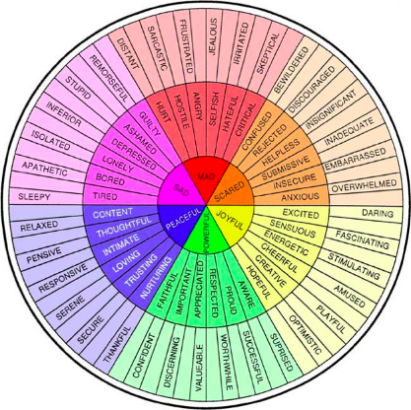
What happened?
Where did it happen?
When did it happen?
EVENT MAP
Who was involved in the event?
How did it happen?
Why did it happen?
Using your emotions wheel, surround your map with words to show how you think Deo might be feeling at this point.
Notes:
Using graphic organisers – see Hodder examples online. Pupils to decide on a key event in chapters 1-5 and complete chart in their books. Pupils should then scatter character emotions around the outside of the organiser.
Add emotions! Pupils will need to justify the emotions they have chosen. The aim is to use the words correctly, so they should look up words that they are unsure of. For those that need an extension, they could add a brief sentence below the words explaining why they chose them.
Thanks very much to Claire Houslop, Brighton teacher and reading expert for this slide.

Slide 33
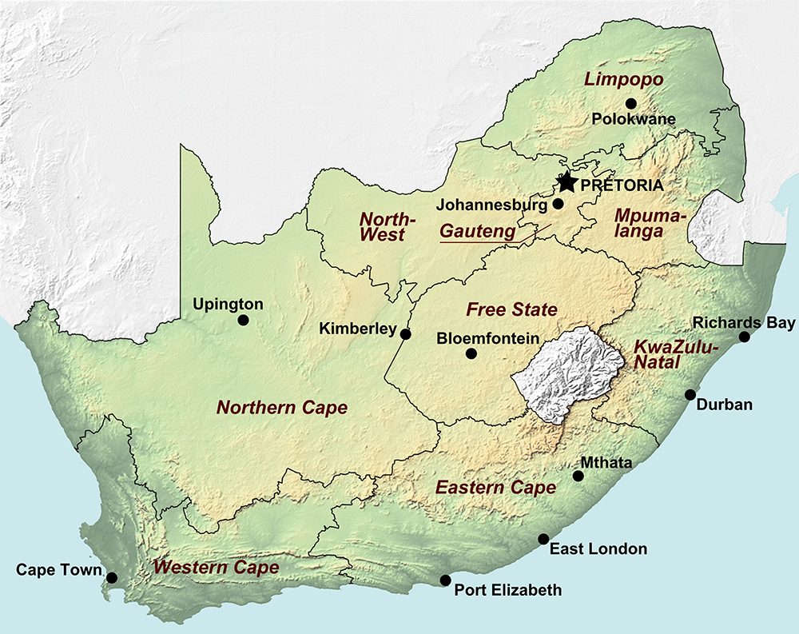
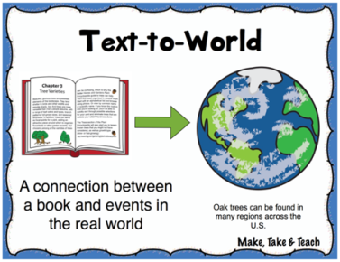
Cape town is the capital city of the Western Cape. This is where Deo joins the Homeless Football team.
Can you find Cape town on the map and label it?
Notes:
Thanks very much to a local, Brighton teacher and reading expert, Claire Houslop, for these slides: Plot Cape Town after you have read chapter 22 of Now is the Time for Running.

Slide 34
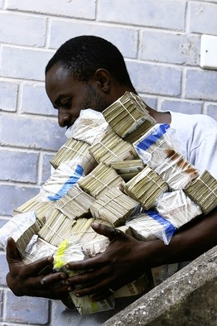
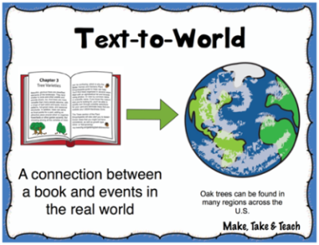
Now is the Time for Running: applying Text-World knowledge
‘a football stuffed with a billion worthless dollars’
The Zimbabwean dollar (ZW$) is the official currency and it is one of the least valued currencies in the world.
In 2007 the exchange hit
ZW$ 200,000,000 to US$ 11
US$1 to £1.98
Can you work out how much money Deo and Innocent have in their football?
Billion = 9 noughts
Million = 6 noughts
A man in Harare, Zimbabwe, carried cash for groceries in 2008
Notes:
Explain that to solve the financial crisis, Mugabe authorised the printing of more money (the trillion dollar bill was introduced) and this devalued the currency. Make links with inflation crisis in Germany – wheelbarrows of money to buy bread.
Ask pupils to work out how much 1billion ZW$ is in US$ then in £
Billion = 9 noughts
Million = 6 noughts (so 200million)
1,000,000,000 / 200,000,000 x 11 = US$55 x £1.98 = £108.90
Stage one: We need to work out how many 200,000,000 there are in a billion.
Stage two: we times that number by 11 US dollars.
Stage three: times that by £1.98 to convert to sterling.
NB See youtube examples of the 2008 riots in South Africa
Thanks very much to Claire Houslop, Brighton teacher and reading expert for this slide.

Slide 35
What must teachers know about reading? A bit more theory in these last 2 slides
How do readers read whole texts? Situation Models (Kintsch, 1998)
Why do some readers struggle to comprehend text?
Why is it important to read many whole texts? Reciprocal relation between reading amount & reading comprehension
Role of engagement & reader identity; Choice of texts - becoming a ‘reader’: diverse text representations: developing persistence, habits (Retelsdorf et al, 2011; Cremin et al, 2014, Cliff-Hodges, 2014; Guthrie & Klauda, 2014)
Role of inference, story-structure, self-monitoring, vocabulary, reading aloud (Oakhill & Cain, 2012 Oakhill et al, 2015)
Compounding effect of disadvantage: language gap at 5 yrs & reading-experience gap magnifies over time (Blanden & Machin, 2010; Hart & Risley, 2003; NLT, 2022; Baye et al, 2019)
Community reading & dialogic talk: class/groups: reading aloud for interpreting, enjoyment + fluency, questioning, self-monitoring… (e.g. Okkinga et al, 2014; Sutherland, 2015)
Notes:
How do ‘good’ readers read whole texts & construct meaning, creating mental models?
Most imp. 3 elements of reading: inference, monitoring comp – know when stuck – know how to apply a strategy and become unstuck/resolve comp problem; story-structure (Oakhill & Cain, 2012). Role inference at sentence, para, chapter & whole-text levels. Struggling readers: 1) weaknesses in working-memory – can’t retain sense of narrative from sentence to chapter, 2) compounded by slow decoding/weak fluency – strong expressive reader reading aloud, supports their fluency & comp.- weak inference even when they have relevant knowledge – can’t apply – must learn to question & apply that knowledge. 3) Weak comprehenders/inferers – must practise by reading/trying to infer
Why do some readers struggle to comprehend text? e.g. memory, language-processing, cognitive resources overloaded by weak decoding & fluency, problems with inference-making, lack of strategies & reading practice (Oakhill et al, 2015).
Why is it important to read many whole texts? Reciprocal relation between frequent reading, amount (exposure to print) & reading comprehension, esp. extended narratives: the ‘Matthew effect’ the ‘rich’ get ‘richer’, the ‘poor’ ‘poorer’ (Kintsch, 1998; Westbrook, 2013; Cunningham & Stanovich, 1998; Torppa et al, 2020; van Bergen et al, 2020; Mol & Bus, 2011). So, Students need to read many whole, extended texts to improve their reading comprehension.
Roles of reading engagement, inference, story-structure, self-monitoring & vocabulary (Guthrie & Klauda, 2014; Oakhill et al, 2015). Reading for pleasure at 10 years helps overcome disadvantage - a stronger predictor of GCSE success than parents’ education (Sullivan & Brown, 2015).
Compounding effect of disadvantage: language gap at 5 yrs & reading-experience gap magnifies over time. These students are less likely to read independently & do not gain adequate whole-text reading experience in school (Blanden & Machin, 2010; Hart & Risley, 2003; NLT, 2022; Baye et al, 2019) - BUT access to books & encouragement can change this(Clark & Akerman, 2011; Allington et al, 2010; Cremin et al, 2014). Need to place extended reading at heart of reading lessons, not expect extended reading to take place at home – exacerbates disadvantage – although of course RfP independently is another aim
Community reading & dialogic talk: class/groups: reading aloud for fluency, student/teacher questioning, self-monitoring, interpreting, enjoyment (Okkinga et al, 2014; Sutherland, 2006, 2015; Cremin et al 2014)
Choice of texts - becoming a ‘reader’: developing reading self-concept or identity, persistence & skills to overcome challenges (Retelsdorf et al, 2011; Cremin et al, 2014) – culturally diverse texts
Reading engagement: Reading for pleasure at 10 years helps overcome disadvantage - a stronger predictor of GCSE success than parents’ education (Sullivan & Brown, 2015).
Reading extended fiction, as opposed to other varieties of text, online or print, is particularly related to improvements in reading comprehension (Jerrim & Moss, 2019) Struggling readers need to gain skills, experience of whole-text reading, motivation & confidence as ‘readers’ (Stanovich, 1986; Mol & Bus, 2011; van de Broek, 1997)
How do ‘good’ readers read whole texts & construct meaning, creating mental models? (Kintsch, 1998)
Why do some readers struggle to comprehend text? e.g. memory, language-processing, cognitive resources overloaded by weak decoding & fluency, problems with inference-making, lack of strategies & reading practice (Oakhill et al, 2015)
Why is it important to read many whole texts? Reciprocal relation between reading amount & reading comprehension, esp. extended narratives: the ‘rich’ get ‘richer’, the ‘poor’ ‘poorer’ (Kintsch, 1998; Westbrook, 2013; Cunningham & Stanovich, 1998; Torppa et al, 2020; van Bergen et al, 2020; Mol & Bus, 2011)
Role of reading engagement, inference, story-structure, self-monitoring & vocabulary (Guthrie & Klauda, 2014; Oakhill et al, 2015)
Compounding effect of disadvantage: language gap at 5 yrs & reading-experience gap magnifies over time. These students are less likely to read independently & do not gain adequate whole-text reading experience in school (Blanden & Machin, 2010; Hart & Risley, 2003; NLT, 2022; Baye et al, 2019)
Community reading & dialogic talk: class/groups: reading aloud for fluency, student/teacher questioning, self-monitoring, interpreting, enjoyment (Okkinga et al, 2014; Sutherland, 2015; Cremin et al 2014)
Choice of texts - becoming a ‘reader’: developing reading self-concept or identity, persistence & skills to overcome challenges (Retelsdorf et al, 2011; Cremin et al, 2014)
How do ‘good’ readers read whole texts & construct meaning, creating mental models? (Kintsch, 1998)
Why do some readers struggle to comprehend text? e.g. memory, language-processing, cognitive resources overloaded by weak decoding & fluency, problems with inference-making, lack of strategies & reading practice (Oakhill et al, 2015)
Why is it important to read many whole texts? Reciprocal relation between reading amount & reading comprehension, esp. extended narratives: the ‘rich’ get ‘richer’, the ‘poor’ ‘poorer’ (Kintsch, 1998; Westbrook, 2013; Cunningham & Stanovich, 1998; Torppa et al, 2020; van Bergen et al, 2020; Mol & Bus, 2011)
Role of reading engagement, inference, story-structure, self-monitoring & vocabulary (Guthrie & Klauda, 2014; Oakhill et al, 2015)
Compounding effect of disadvantage: language gap at 5 yrs & reading-experience gap magnifies over time. These students are less likely to read independently & do not gain adequate whole-text reading experience in school (Blanden & Machin, 2010; Hart & Risley, 2003; NLT, 2022; Baye et al, 2019)
Community reading & dialogic talk: class/groups: reading aloud for fluency, student/teacher questioning, self-monitoring, interpreting, enjoyment (Okkinga et al, 2014; Sutherland, 2015; Cremin et al 2014)
Choice of texts - becoming a ‘reader’: developing reading self-concept or identity, persistence & skills to overcome challenges (Retelsdorf et al, 2011; Cremin et al, 2014)

Slide 36

Our Year 7s are telling us – for the first time - they’ve never read a whole book! Primary teachers are under such pressure with the KS2 tests that they often focus on extracts now. (Teachers interviewed in 1st Impact Case Study, 15/11/2017)
14-yr olds who read often & independently know 26% more words than those who never read. Those from book-loving homes know 42% more words (Sullivan, 2017)
The more texts you read, the better your vocab, comprehension and cognitive skills. The gap opens up at secondary, where the reading challenge intensifies and the gap between ‘rich’ and ‘poor’ readers widens...(Cunningham & Stanovich, 1998; the Faster Read, Sutherland, Westbrook, Oakhill and Sullivan, 2023)
Notes:
Cunningham and Stanovich, 1998 and our study – Sutherland et al, 2023 – the more you read, the better you get at comprehending as you are forced to tackle and overcome comprehension difficulties – this improves your skills for the next book AND gives you the motivation and self-belief to know you can do this – ie enhances your identity as a reader.
Allington et al, - gave disadvantaged students, also weak readers, 15 books over the summer holidays, which they chose themselves and were allowed to keep, and they maintained their comprehension levels along with more advantaged peers, whereas normally, a gap opens up across the summer holidays, with more advantaged and typically stronger readers reading a lot during the summer and disadvantaged students not reading – optimistic study!! ie simply giving children from more disadvantaged backgrounds easy access to books and encouragement to read will help them keep up their reading comp. skills. See many libraries’ campaigns to get children reading in the summer – schools should try to promote these initiatives & join forces with local libraries.
So, there is huge evidence that children need to read a lot and be exposed to a volume of print to develop their reading skills, but the question is: how much reading of whole books are they doing in their actual English lessons? This was our focus in the research – if children read 2 whole books in a term & teachers focus on engagement/motivation, as well as strategies, this should give poorer, reluctant readers the experience of ‘being a reader’ & enjoying a whole book, as well as the feeling of confidence (and satisfaction) that comes with getting to the end of a novel. Will this reading model develop poor readers’ reading comp. skills? In future studies, we would also want to investigate whether the model also stimulated students to do more independent reading (NB our teacher participants reported that they did, but this was not a specific focus of this study).

